Slide 1
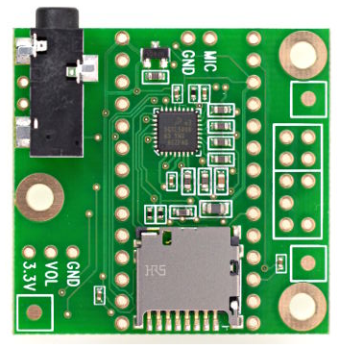
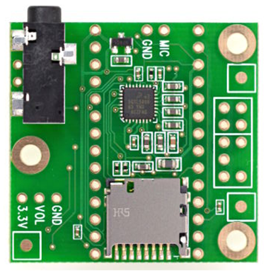
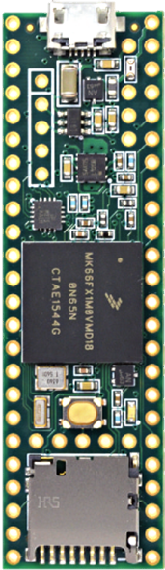
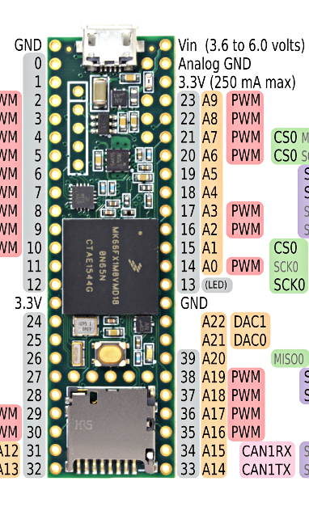
Existing COTS Hardware
Teensy 3.6
Dev Board
Teensy
Audio Board
Teensy
Audio Stack
Creare seeks to replace the Teensy Audio Board
with a new Creare Audio Board

Slide 2


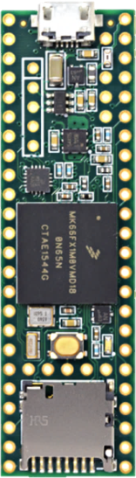


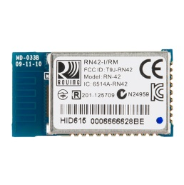
Rev 2016-12-06 12:50pm
Creare Audio Board (“Tympan 1”)
Notional Layout
Creare
Audio Board
With Teensy 3.6
Mounted
J5
Hole
J10
U4 (Codec)
Move as desired, but keep leads to J5 short!
J5
Hole
J10
D1
D2
D1
D2
Mic2:
“Right” Mic
U4
Mic1: “Left” Mic
U4
Mic
R
U2
Mic
L
Mic
R
U2
Mic
L
OFF
Power Supplies can go anywhere
OFF
SW1:
Power
U3
J4
U3
J4
ON
Battery
Connector
ON
IN3
L
IN3
L
~9.75 cm
Line-O
R
Line-O
R
L
L
G
+
R
PCB Cut-away to allow wiring from J4 to go to the battery underneath
G
+
R
J6
J6
R6
Pot
R6
Pot
D4
D5
D3
4-40 Clearance Holes (Free Fit)
D4
D5
D3
TYMPAN 1
TYMPAN 1
Teensy 3.6: 61Lx18W mm
Note: The battery will go underneath, so please keep components on the bottom to a minimum to prevent interfering with the battery.
RN42: 25.8L x 13.4W mm
~3.7cm
4-40 Clearance Hole (Free Fit)
Codec: 5.15 x 5.15 mm
Battery Connector. 9mm W

